Slide 1
Performance analysis framework for base station placement using IEEE 802.11
Group study presentation
18.03.2020
Rustam Khakov
Kirill Kukartsev
Zufar Makhmutov
Notes:
Kirill
1

Slide 2
Problem Description

Slide 3
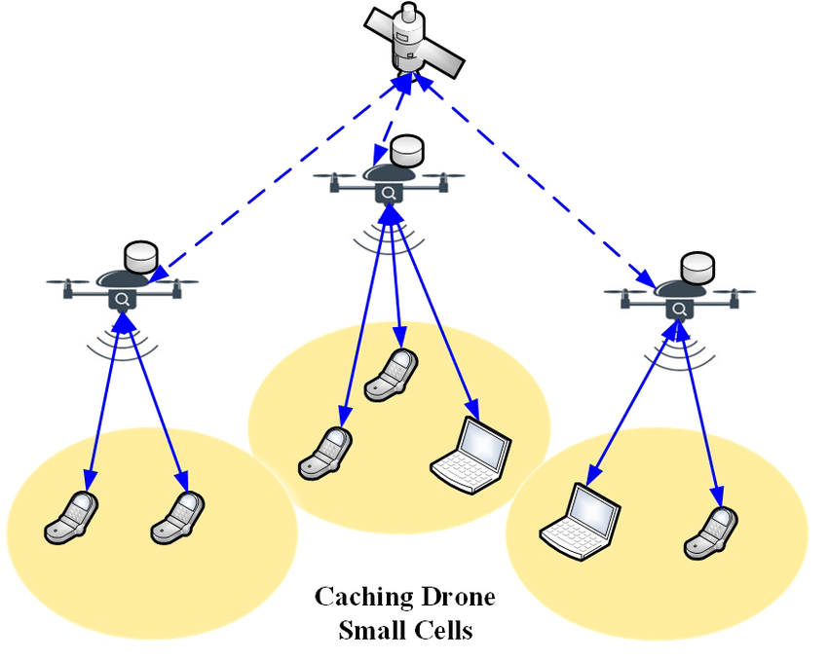
Motivation
Mobile users’ demand increasing
Higher speed, lower latency
More data and services
Tendency to be located closely to users
2G: Macro-cells
3G - 4G: Micro-cells
5G: Pico-cells
Idea: Unmanned Aerial Vehicle with
Base Stations (UAV-BS)
Problems:
How to design a placement algorithm?
How to evaluate correctness of the algorithm?
How to coordinate the elements of mobile
communication system infrastructure?
Increasing coverage and capacity
with UAV equipped with base stations[1]

Slide 4
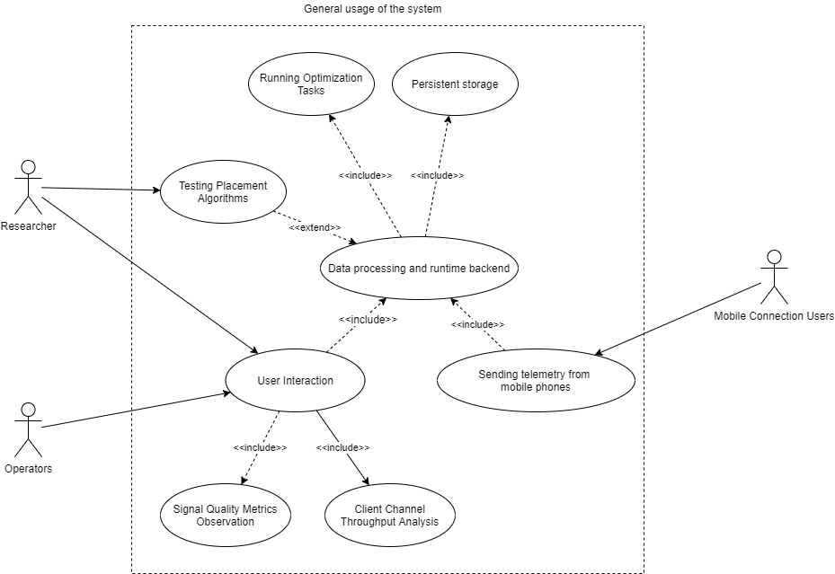
A General Use-Case for Possible Solution
A Generalized Use-Case for a Placement Algorithm Experimental Framework

Slide 5
Architecture Description

Slide 6
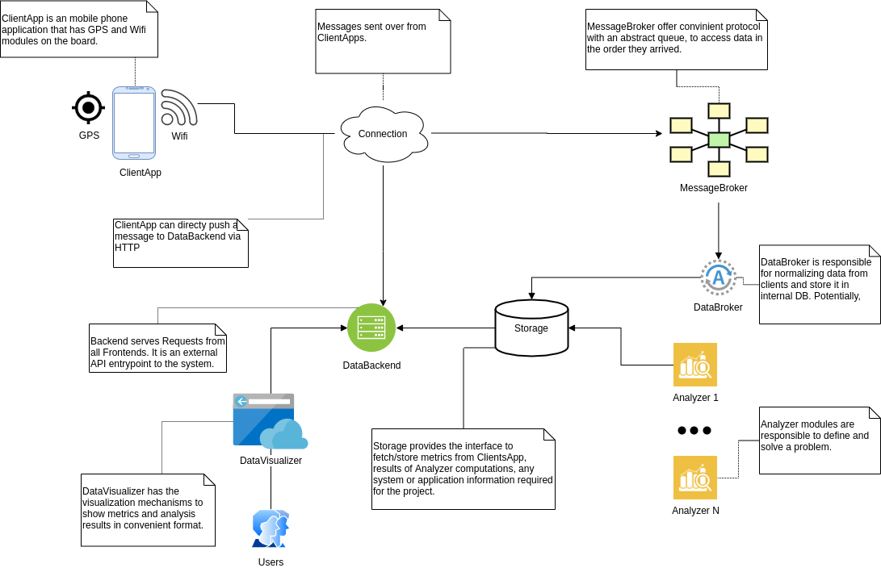
Abstract System Design
Abstract Design for component interaction for the given possible problem solution

Slide 7
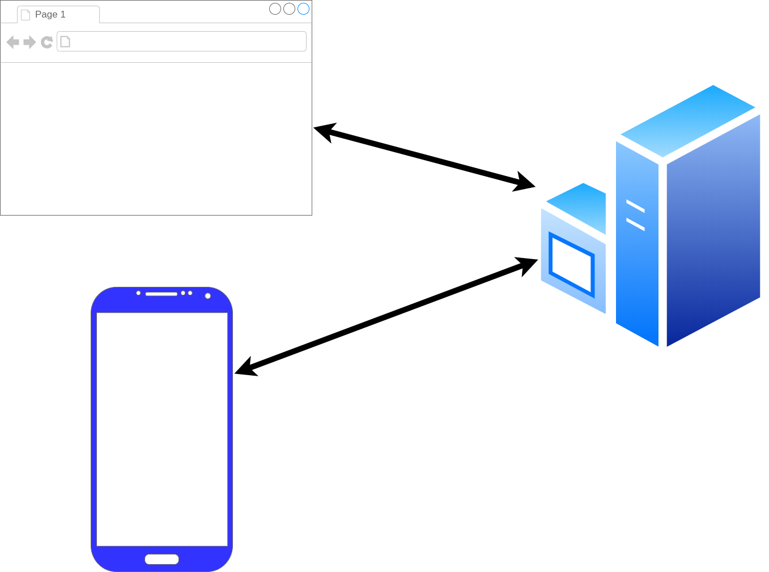
Framework Architecture Description
GPS_Frontend
GPS_Tracker
GPS_Android
Three main component of framework: a phone (GPS_Android), user interface (GPS_Frontend), data processing (GPS_Tracker)
Notes:
Rustam
1

Slide 8
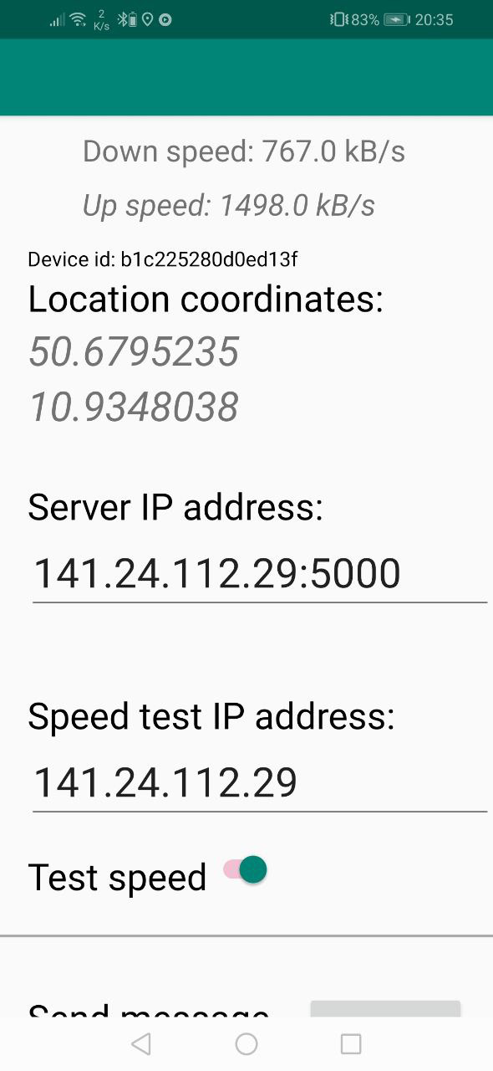
Android Component
Measure:
GNSS location
RSS of Wifi connection
Connection speed
Requirements:
- Android above 4.0
- GNSS connection
- Access to Wifi
GPS_Android installed on an Android SmartPhone

Slide 9
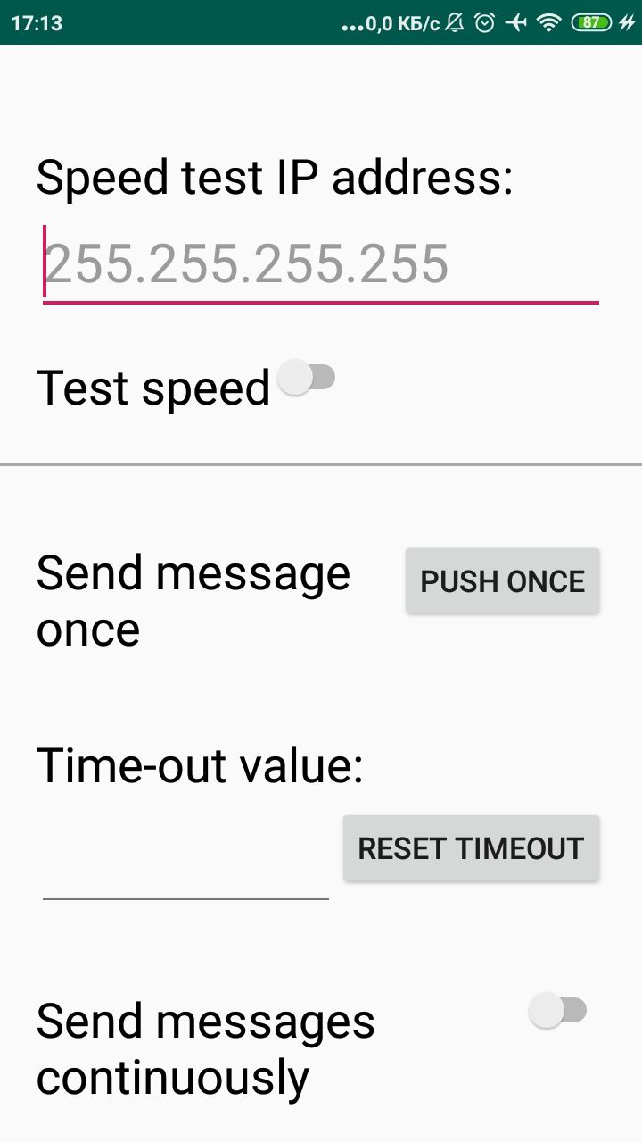
Activities:
- Send measurement result to given server
- Measure data periodicaly on
background with given timeout

Slide 10
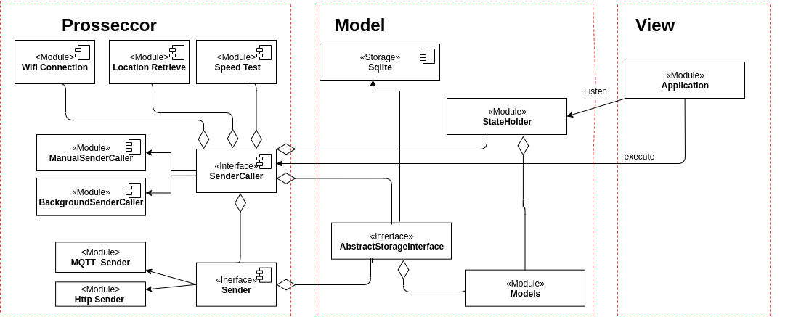
Android Application Architecture

Slide 11
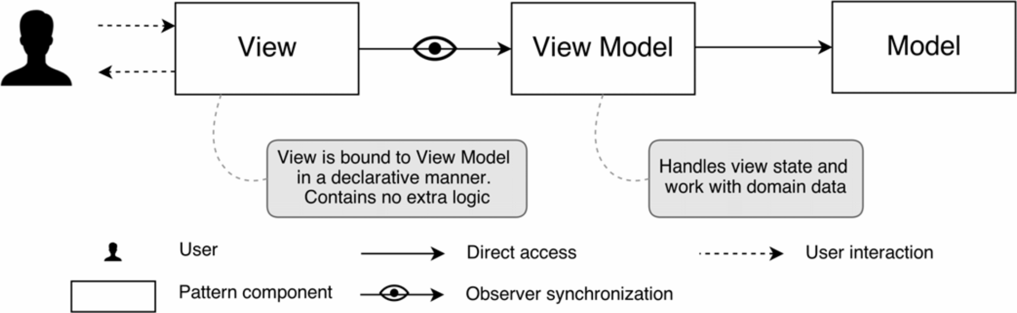
GPS_Frontend
User Interface to interact with GPS_Tracker
Single Page Application (SPA)
Based on web technologies
Main features
Model-View-ViewModel design pattern
Parallel execution, asynchronous calls
Reactivity
Extensibility
Representation of MVVM design pattern elements
Notes:
Now we will discuss the most visual part of our framework – GPS_Frontend.
This is a web based user interface to access link measurement data from mobile phones. Also it provides functions to run optimization tasks and analyze result of them.
User Interface built with Model-View-ViewModel design pattern shown on the slide.
Here we have three components:
View – objects shown to user, like tables, div, columns, images.
ViewModel – component that defines operation on data representing in Model. May separate partly data contract with Model component.
Model – storage for user data. There are specified getters and setters for data objects. All data sink communication (to external DB, local DB, different transformation) defined here.
1

Slide 12



Technologies for GPS_Frontend
Components
VueJS – a Javascript framework for SPA
Vuex – data storage library
Vuerouter – URL path router
Plotly – plotting library
Bootstrap – web design library
Alternatives
Angular – by Google, functional, but monolithic
React – by Facebook, flexible, but not easy-to-go
VueJS – by community, flexible, lightweight, but not so functional
The most popular libraries logos for modern web projects: Angular, React, VueJS
Notes:
We can point out 5 technologies in GPS_Frontend
- VueJS - a Javascript web framework, the skeleton of application
- Vuex - a unite data storage to share between components
- Vuerouter - URL path routing
- Plotly - to plot figures
- Bootstrap - an open-source toolkip, to make UI good looking.
- Angular has rich functionality, but too complex for that task.
- React is more fexible, but requires more time to get working in.
- Vue.js is a simple framework with an excellent documentation but has a lack of components in the default conguration. It requires additional libraries and components to design required functions.
1

Slide 13
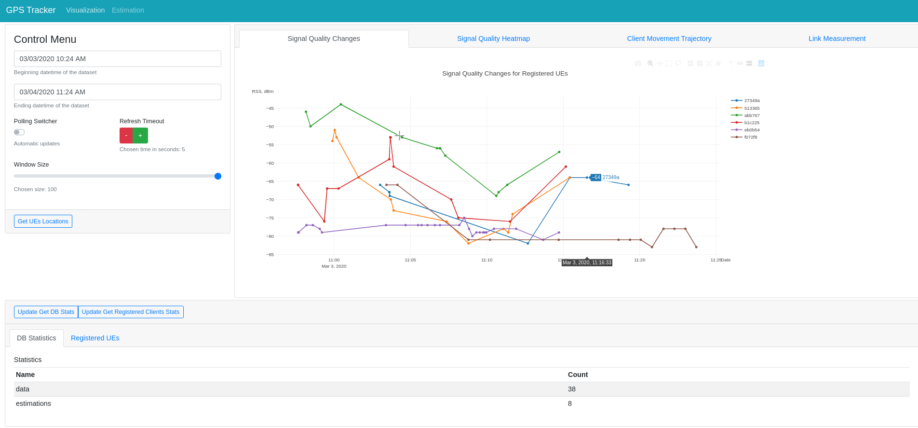
Timeframe,
update
frequency
configuration
GPS_Frontend-Visualization
Location data on given
timeframe
Database
statistics
Layout of the UI implemented by GPS_Frontend. The user access UI in a web-browser
Notes:
This is a view where you can show and analyze measurements received from the phone.
Control Menu
Database Statistics
Graphical View
Signal Changes
Signal Heatmap
Client Measurement Technology
Link throughput Measurements
1

Slide 14
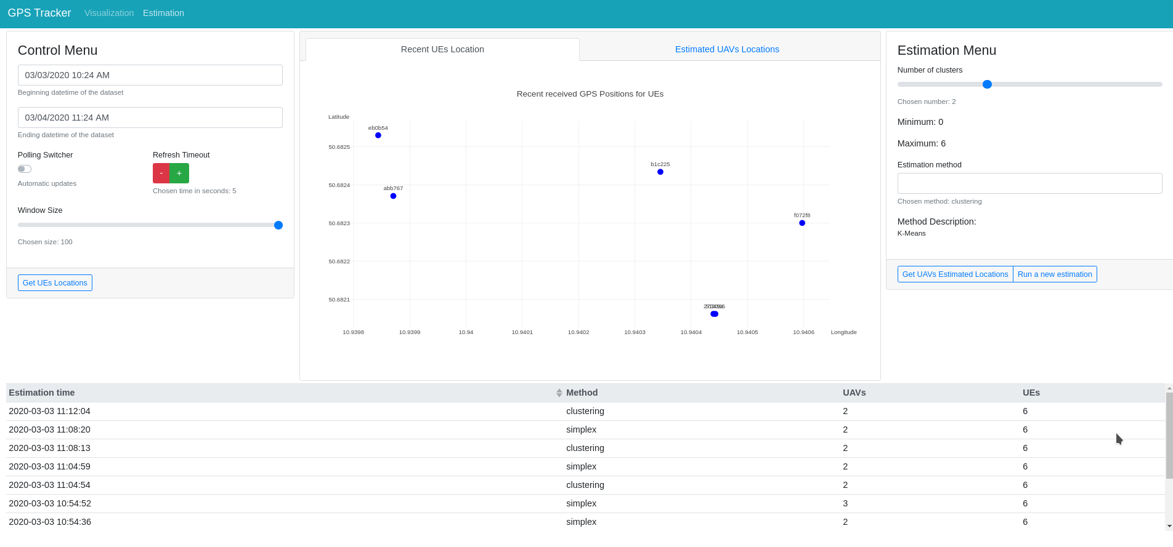
UEs positions for optimization task
GPS_Frontend-Estimation
Choose parameters for new task
Available task results
Notes:
This is another view of GPS_Frontend where you work with placement opltimication algorithms
Control Menu
Estimation Menu
Available Estimation Results
1

Slide 15
GPS_Tracker
Functions
Serve HTTP REST inquires
Process incoming messages from GPS_Android
Dispatch optimization tasks
Key features
Worker design pattern
Python programming language
Key technologies
Lightweight Flask library for HTTP server
Celery task scheduling library
MongoDB NoSQL database
RabbitMQ message queue
Notes:
Then we are going to discuss our backend part called GPS_Tracker.
This is set of backend programs intended to serve user requests, process incoming messages from GPS_Androi and perform optimization tasks.
The GPS Tracker is implemented in Python language. This is a dynamic interpreting language. That is known the performance is not so perfect compared to
static compiled languages, but it has higher changeability property.
1

Slide 16
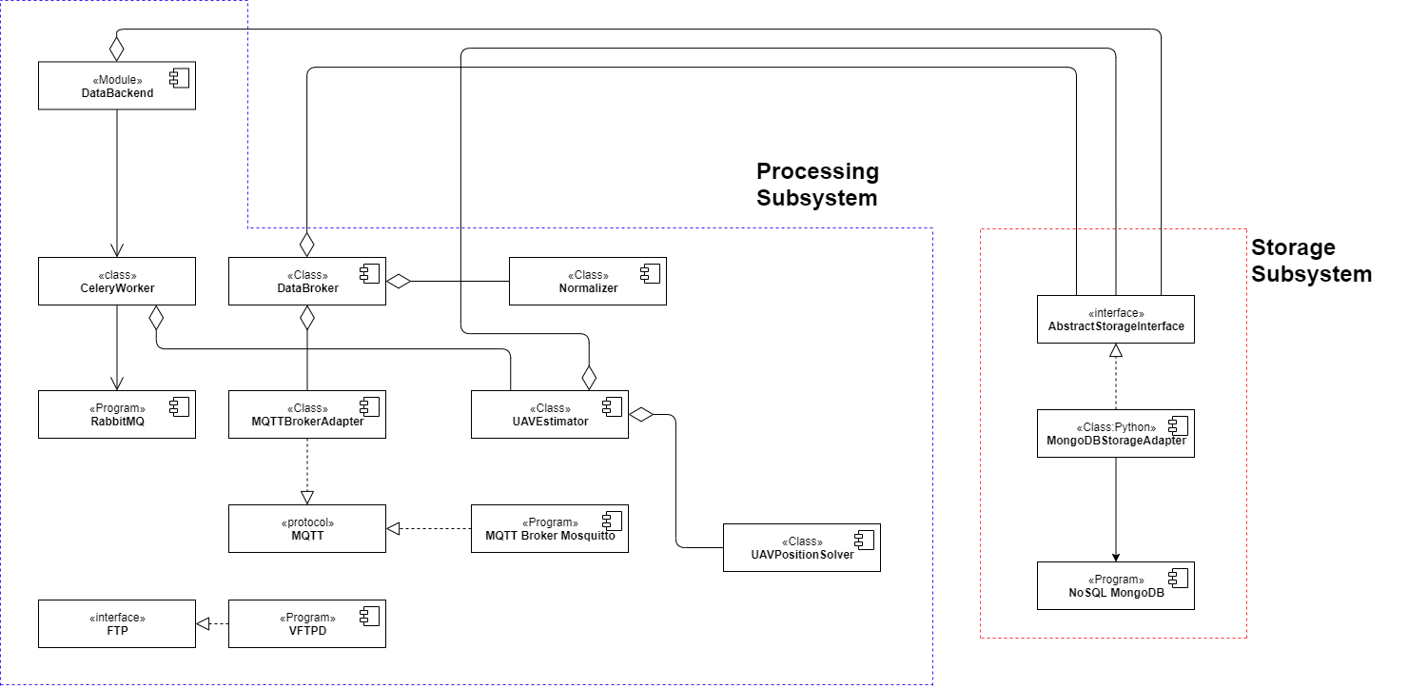
GPS_Tracker Subsystems
Component Diagram for GPS_Tracker subsystems
Notes:
This s component diagram of GPS_Tracker
I would like to point out two subsystem
Processing Subsystem
FTP
MQTT (with middleware) or DataBackend
Storage Subsystem
Interface
MongoDB
1

Slide 17
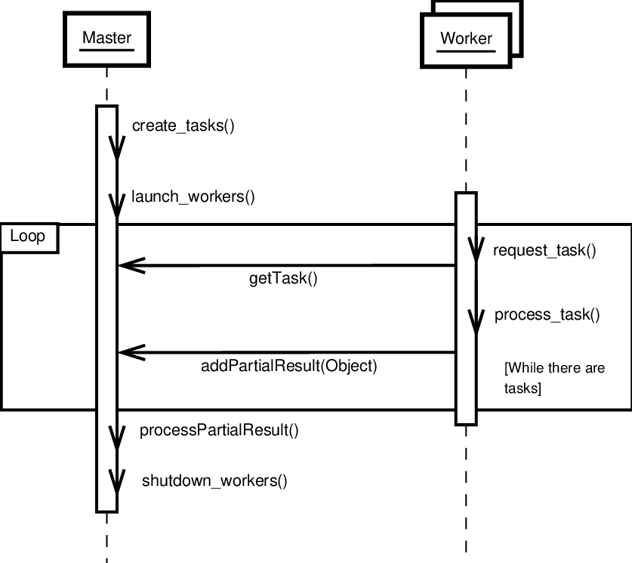
Master-Worker Interaction Diagram
A typical interaction diagram for Worker design pattern
Notes:
Speaking about Worker design pattern, it provides useful architecture:
- Linear performance scaling
Load balancing
Fast feedback to users
1

Slide 18
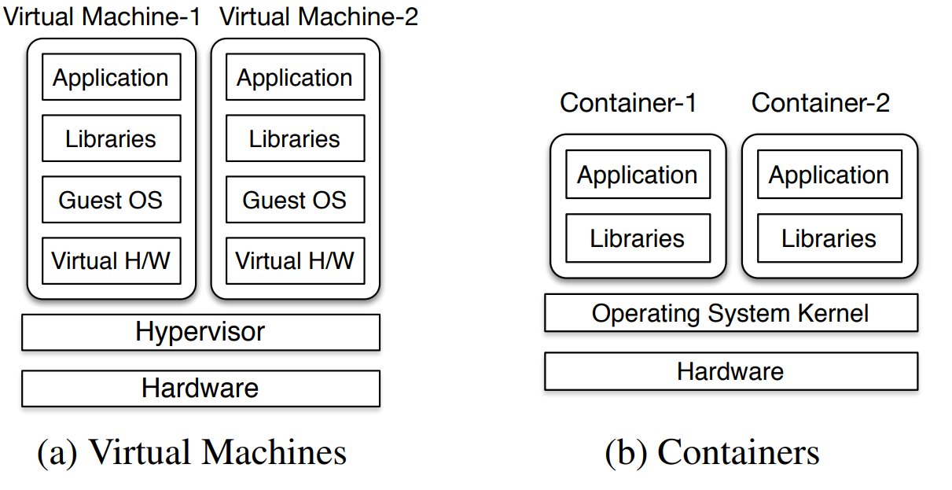
System Component Deployment
Two main cases
Bare-metal installation
Containerized deployment
Key features
Interaction via network
Components can be separated geographically
Virtual machines and containers runtime
Reason for virtual machines
Independence of hardware
Virtual hardware specification control
Single way of installation – just bring an VM image
Reason for containers
Provide ready-to-use program environment
Concept isolation – explicit specification of dependencies
Resource isolation – cgroups and namespaces
Convenient development and deployment
Abstraction Layers for Hardware and Operation system virtualization
Notes:
Another unique think is the deployment process of our framework.
We provide flexible way to install and run the system – you can use real hardware that gives you the maximum performance, or you can use containerized environment.
We provide already prepared virtual machine image, where software components are running in containers.
There are pros and cons when your add so many run-time abstraction, but nevertheless, advantages outweighs possible problems.
1

Slide 19
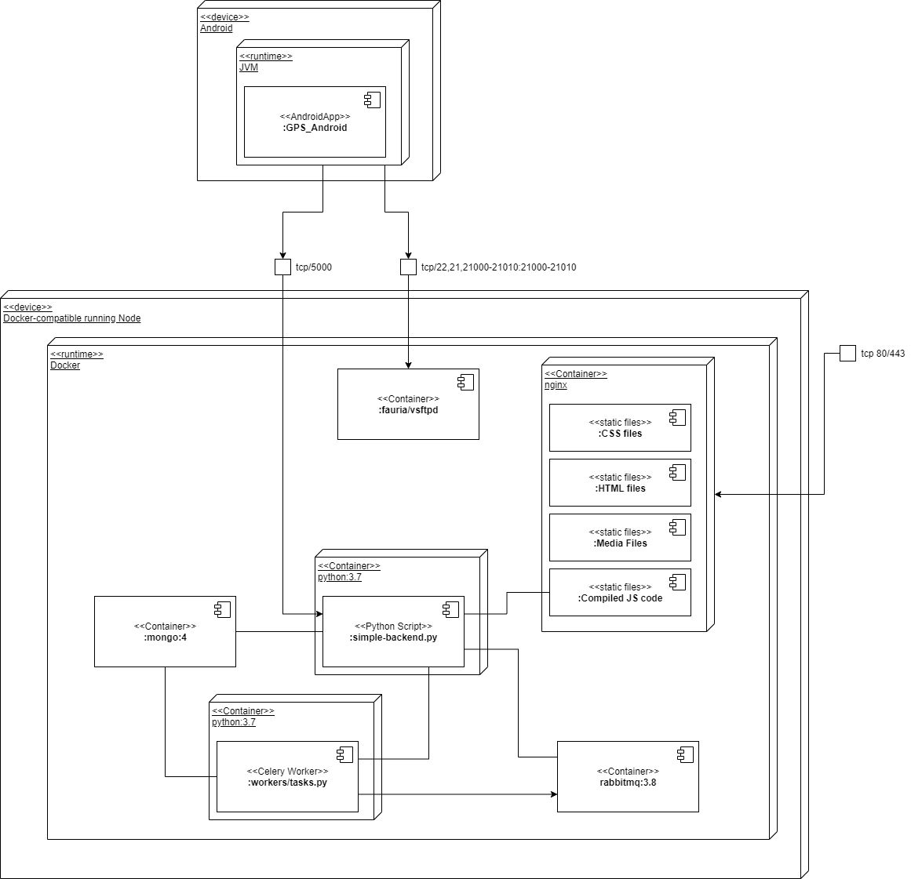
Deployment Diagram In Containers
Notes:
Finally, you can see deployment plan using containers.
We have three entry points:
Tcp 80/443 – to access web interface.
Tcp 5000 – to access REST API
Tcp 21 – to access FTP to perform link throughput measurements
Internally, Docker (a set of platform to run OS-level virtualization – container) set-up overlay network for containers and take care of correct routing between them. Therefore, as long as your containers are running in the same machine or cluster, you don’t have to worry about network connectivity.
1

Slide 20
Experiment Description

Slide 21
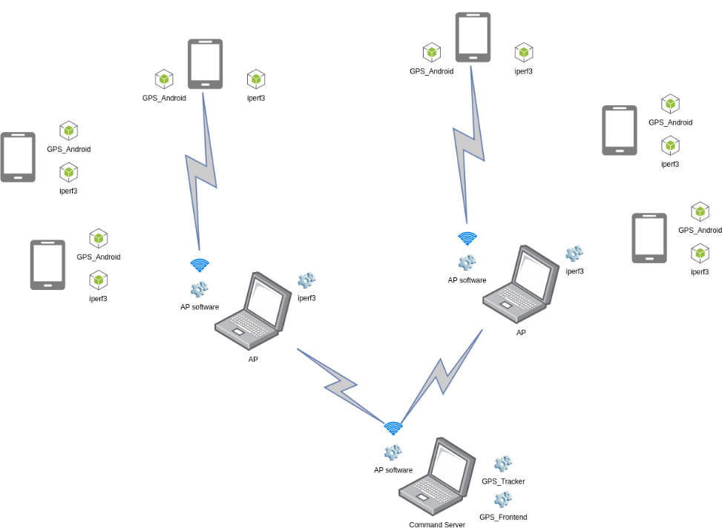
Experiment Description
Communication between components during the experiment
Notes:
Zufar
1

Slide 22
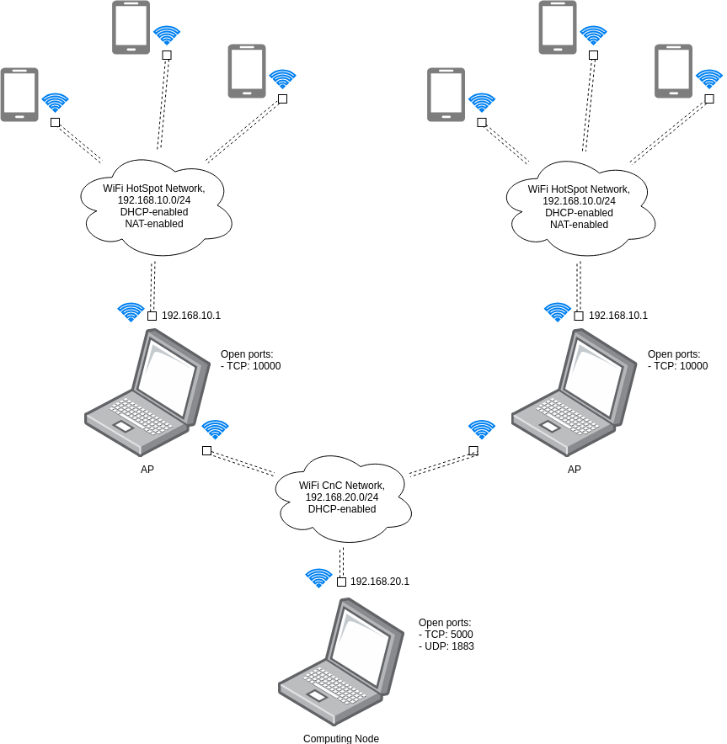
Network Diagram of Experiment
A network scheme of experiment
Notes:
Zufar
1

Slide 23
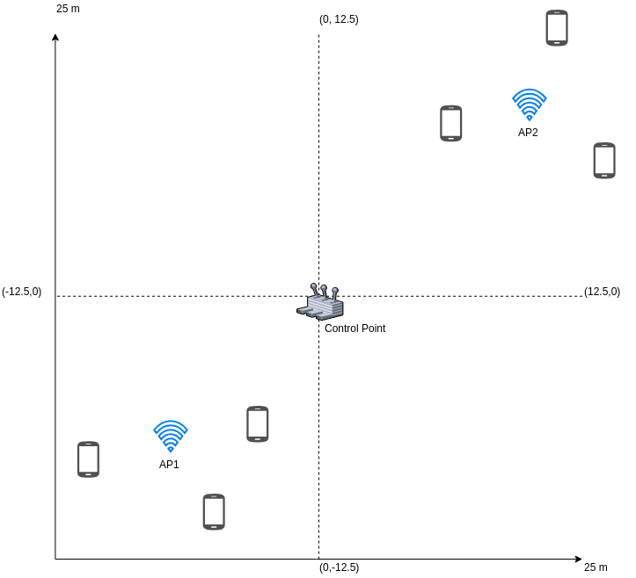
Sub-Optimal Case
Notes:
Zufar
1

Slide 24
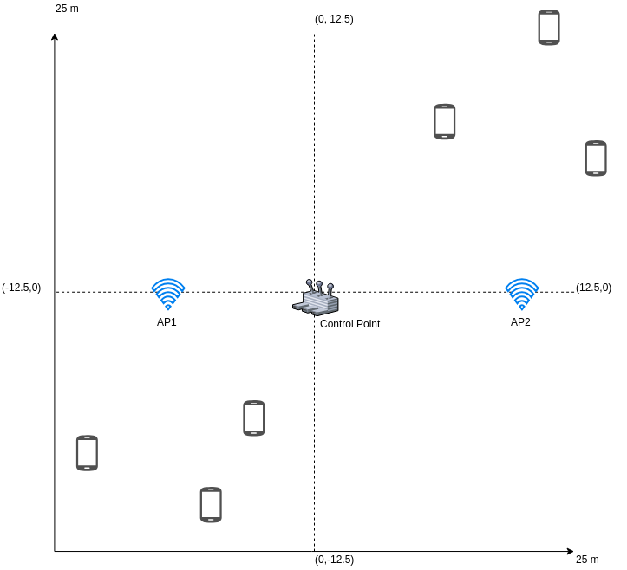
Uniform Case
Notes:
Zufar
1

Slide 25
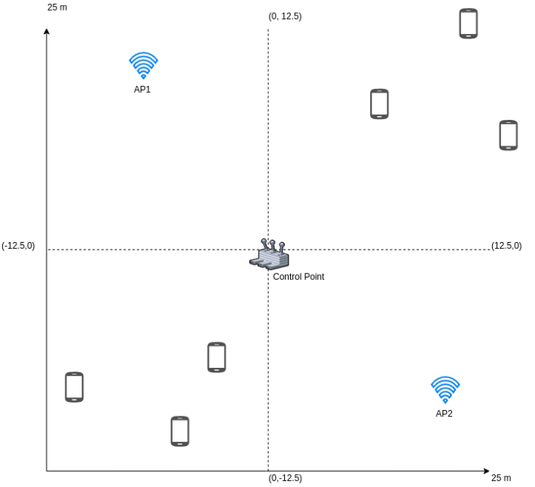
Near-Uniform Case
Notes:
Zufar
1

Slide 26
Experiment 1
Goals:
initial try
as many UEs as possible
collect errors
Conditions:
6 UEs, 1 CnC, 2 APs
cloudy sky, snow on the ground, -1 .. +1 °
Decisions:
resolve the second AP failure reasons
add logs to UEs

Slide 27
Experiment 2
Goals:
check new speed estimation algorithm
discover UEs errors using logs
better track overall changes in front-end
Conditions:
3 UEs, 1 CnC, 1 APs
clear sky, no snow, strong winds
Decisions:
add logging to APs as well
implement direct HTTP requests

Slide 28
Experiment 3
Goals:
compare HTTP requests instead of MQTT
completely refactored app
Conditions:
3 UEs, 1 CnC, 1 APs
indoor (TU Ilmenau Mensa building)
Decisions:
one more scaled-up experiment
run placement algorithm

Slide 29
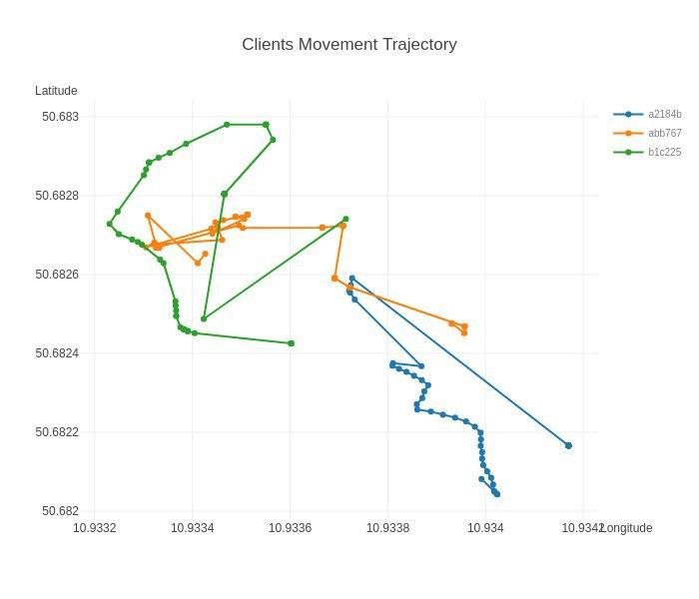

Slide 30
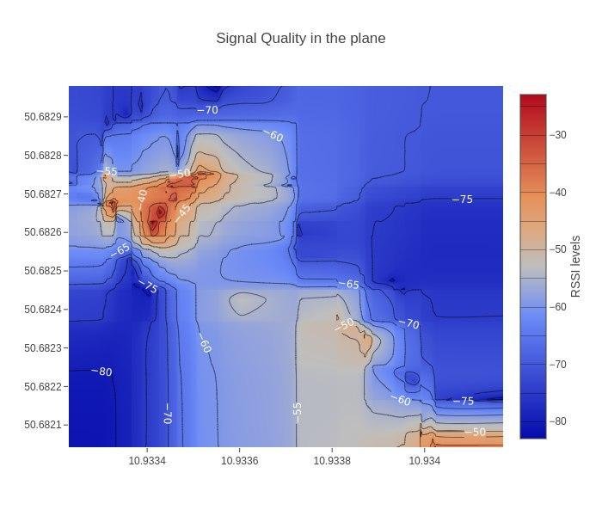

Slide 31
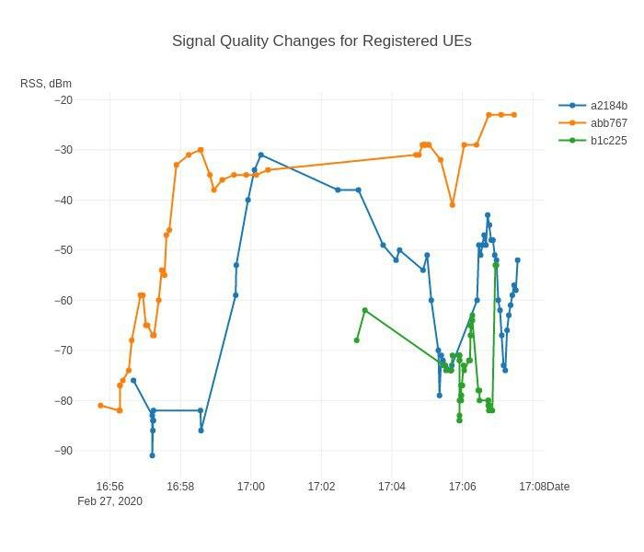

Slide 32
Experiment 4
Goals:
three cases (sub-optimal, uniform, near-optimal)
run placement algorithm
Conditions:
6 UEs, 1 CnC, 2 APs
light rain
Decisions:
analyze collected data
figure out why 2 UEs positions were wrong

Slide 33
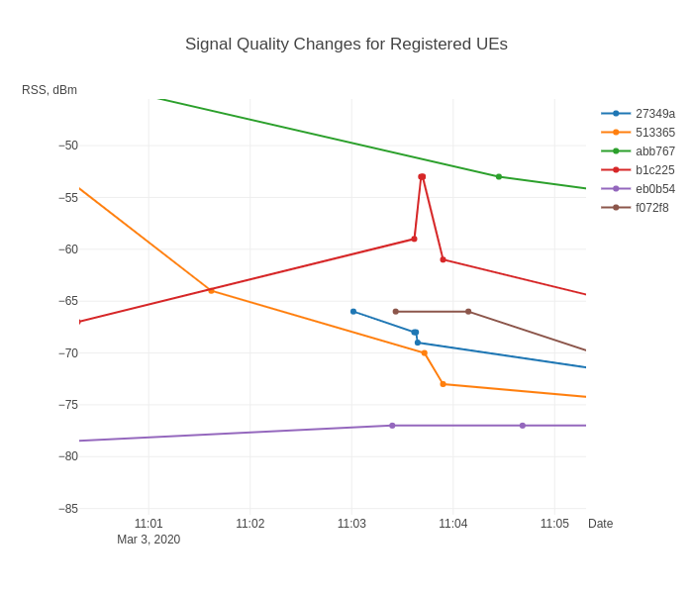

Slide 34
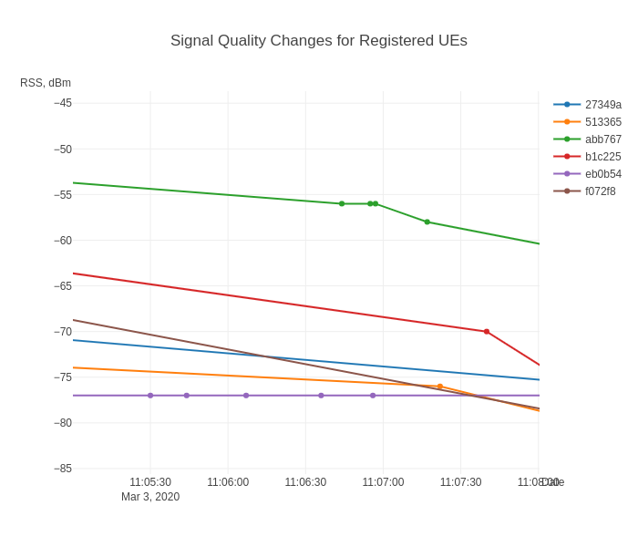

Slide 35
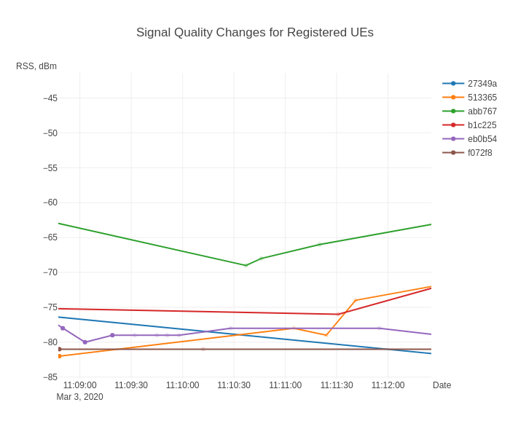

Slide 36
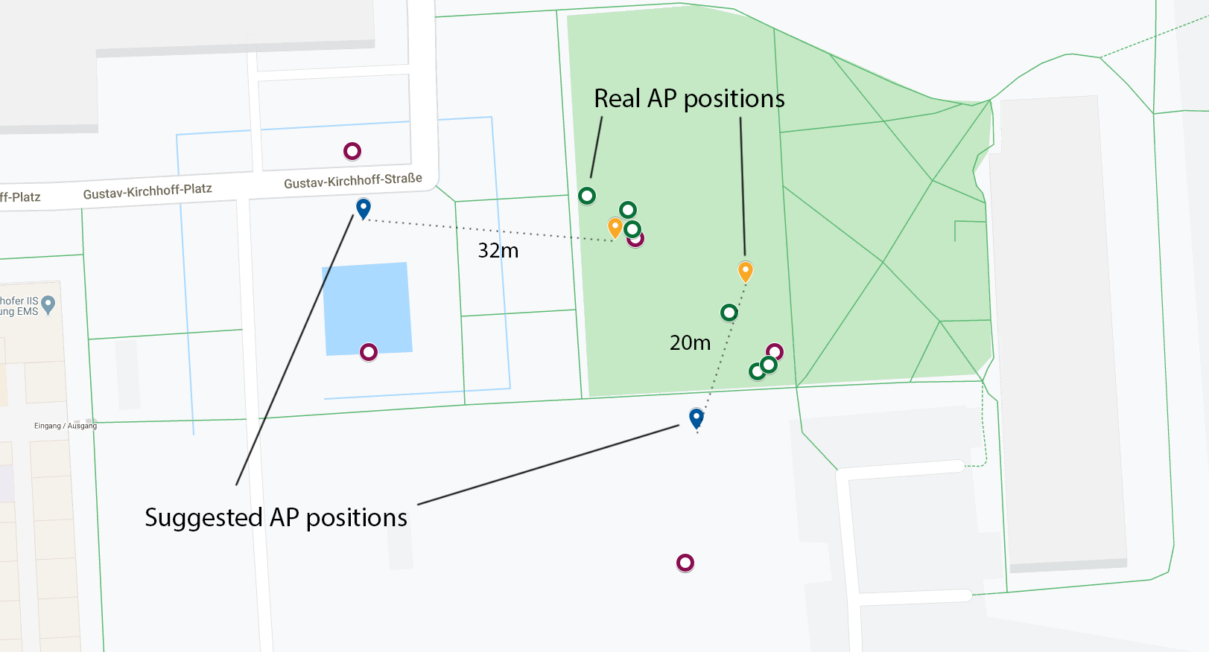
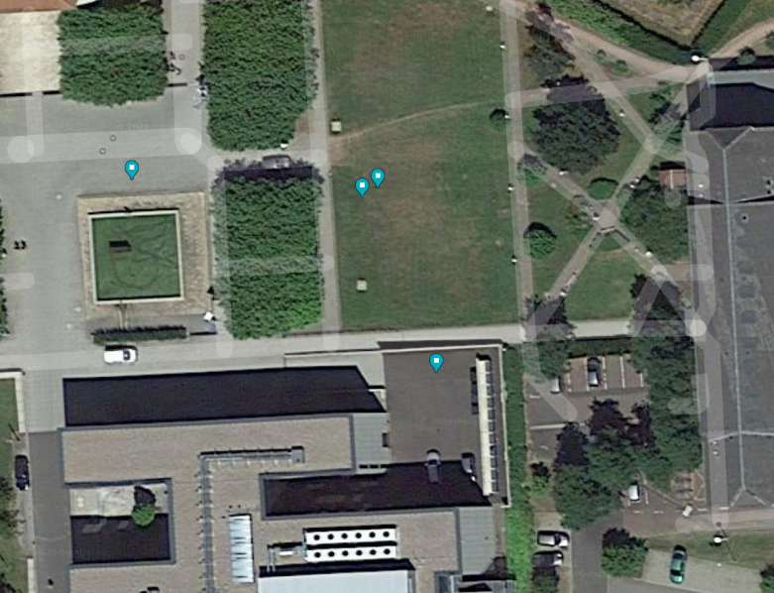
Optimized positions for UAV-BS
Logical map for the original position and suggested optimized position. Coordinates by “clustering” (K-Means) position optimization algorithms are highly biased.
Satellite map with original and suggested positions for UAV-BS layout
Notes:
Zufar
1

Slide 37
Final result
Are the initial aims fulfilled?
 | Aspect | Result
Developed system | Functional properties | Works as expected, but had to alter architecture
Stability / Performance / Usability | Link may suffer collisions
Optimization algorithm | Provided positions | Calculated correctly
Stability / Performance / Usability | Extra data and/or other algo for higher accuracy
Result of 4 performed experiments
Notes:
Zufar
1

Slide 38
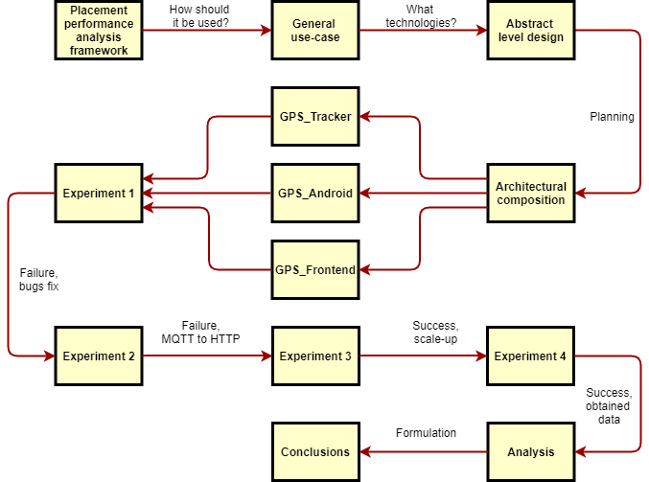
Overview
Notes:
Zufar
1

Slide 39
Thank for your attention!
Questions?

Slide 40
References
A. Syromiatnikov and D. Weyns, "A Journey through the Land of Model-View-Design Patterns," 2014 IEEE/IFIP Conference on Software Architecture, Sydney, NSW, 2014, pp. 21-30. doi: 10.1109/WICSA.2014.13
Ropero, Juan & Tamura, Gabriel. (2017). Characterizing the Impact of Context-Variables in Software Performance Factors: a Domain-Specific Design Patterns Perspective. 10.13140/RG.2.2.13879.42408.
Prateek Sharma, Lucas Chaufournier, Prashant Shenoy, and Y. C. Tay. 2016. Containers and Virtual Machines at Scale: A Comparative Study. In Proceedings of the 17th International Middleware Conference (Middleware ’16). Association for Computing Machinery, New York, NY, USA, Article 1, 1–13.
Zhao, Nan & Yu, F. & Fan, Lisheng & Chen, Yunfei & Li, Jie & Tang, Jie & Nallanathan, Arumugam. (2019). Caching UAV-Enabled Small-Cell Networks. IEEE Vehicular Technology Magazine.
Notes:
1

Slide 41
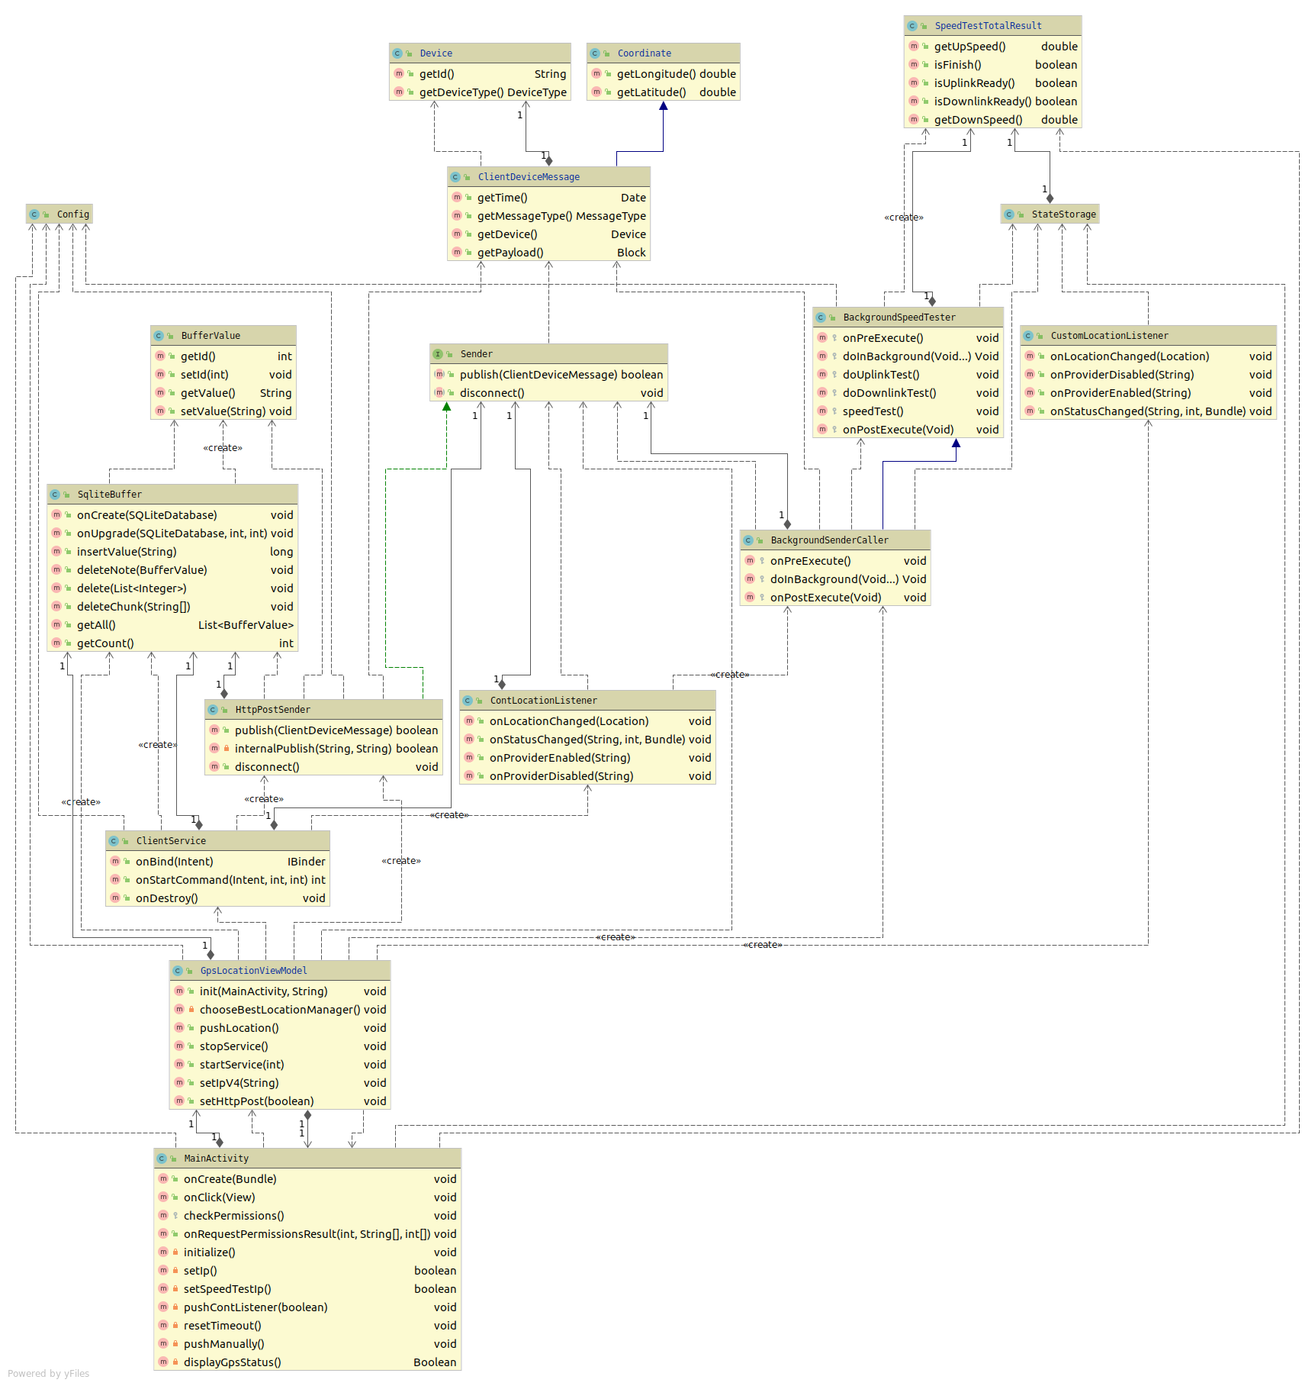
Appendix. Android Class Diagram

Slide 42
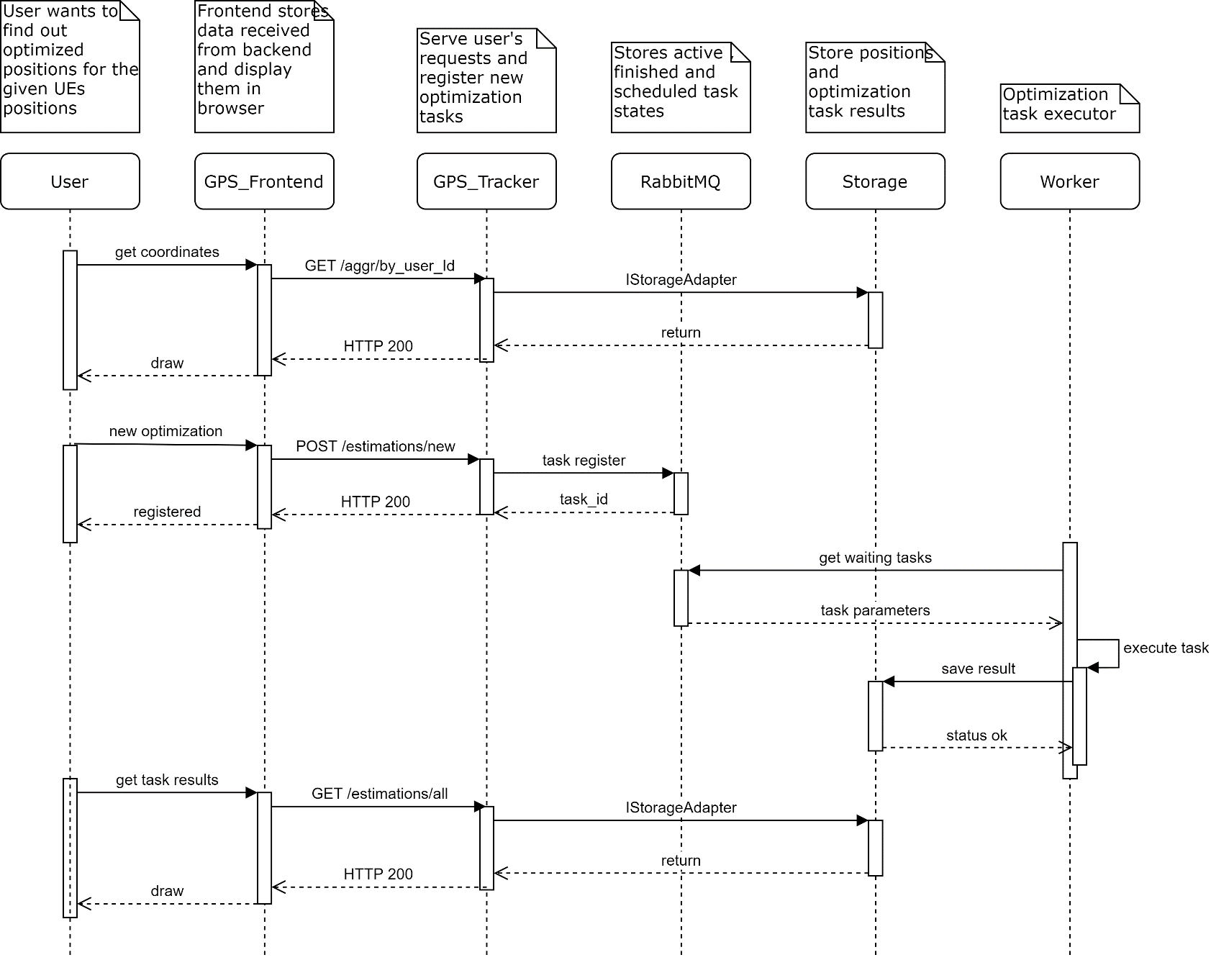
Appendix: UI And Backend Interaction
New optimization task registration
Notes:
Now I would like to discuss one of the most interesting features implemented in GPS_Tracker.
Optimization tasks can take long to complete, and if we start optimization task in the same thread that serving a user request, it will hand the user until the task is done. To make UI responsible and interactive, we use Python Celery library to implement Worker pattern when performing an optimization task.
1

Slide 43

Appendix. Deployment Diagram of Framework
Dockerized infrastructure
Unified interface
Configuration in .config or OS env
A deployment case in container runtime.
Notes:
Kirill
1

Slide 44
Appendix. Resolved problems
Table describes significant moments of workflow
Problem | Group | Resolved way
Can’t install app via apk | Android | Install using Android Studio
Data doesn’t come to CnC | Wi-Fi | Check AP
Silent crash of app | Android | Added logging to file in phone
Error related to MQTT | Software | Replace MQTT with HTTP
Hard to describe software architecture | Report | Refactor code to follow MVVM pattern
Notes:
Zufar
1

Slide 45
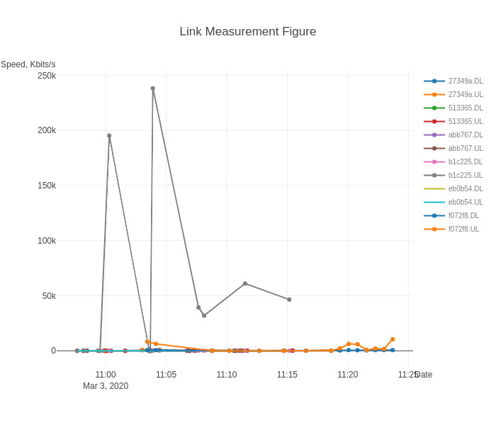
Appendix. Experiment 1/4
Measured signal link speed for uplink and downlink. Mostly metrics are degraded, cannot truly rely on them.
Notes:
Zufar
<номер>

Slide 46
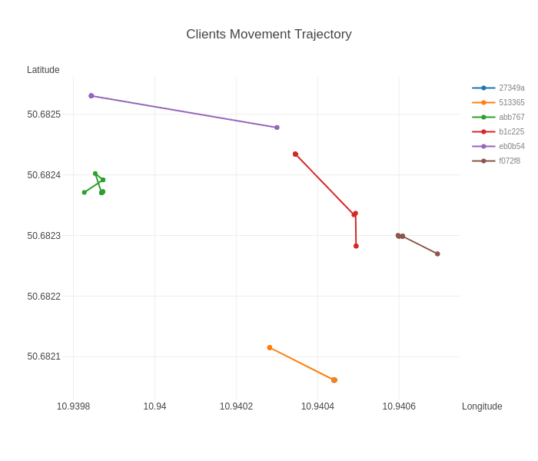
Appendix. Experiment 2/4
Overall detected coordinates changes during the experiment. Clearly shown that GPS has measurement error.
Notes:
Zufar
<номер>

Slide 47
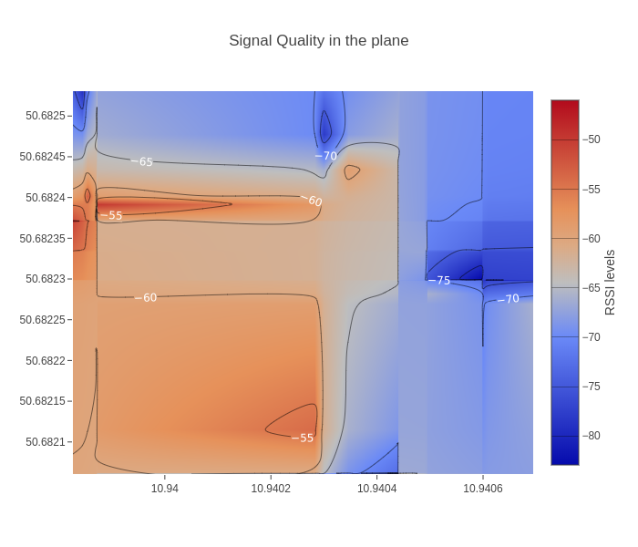
Appendix. Experiment 3/4
The heatmap of quality of WI-FI signal by GPS coordinates.
Notes:
Zufar
<номер>

Slide 48
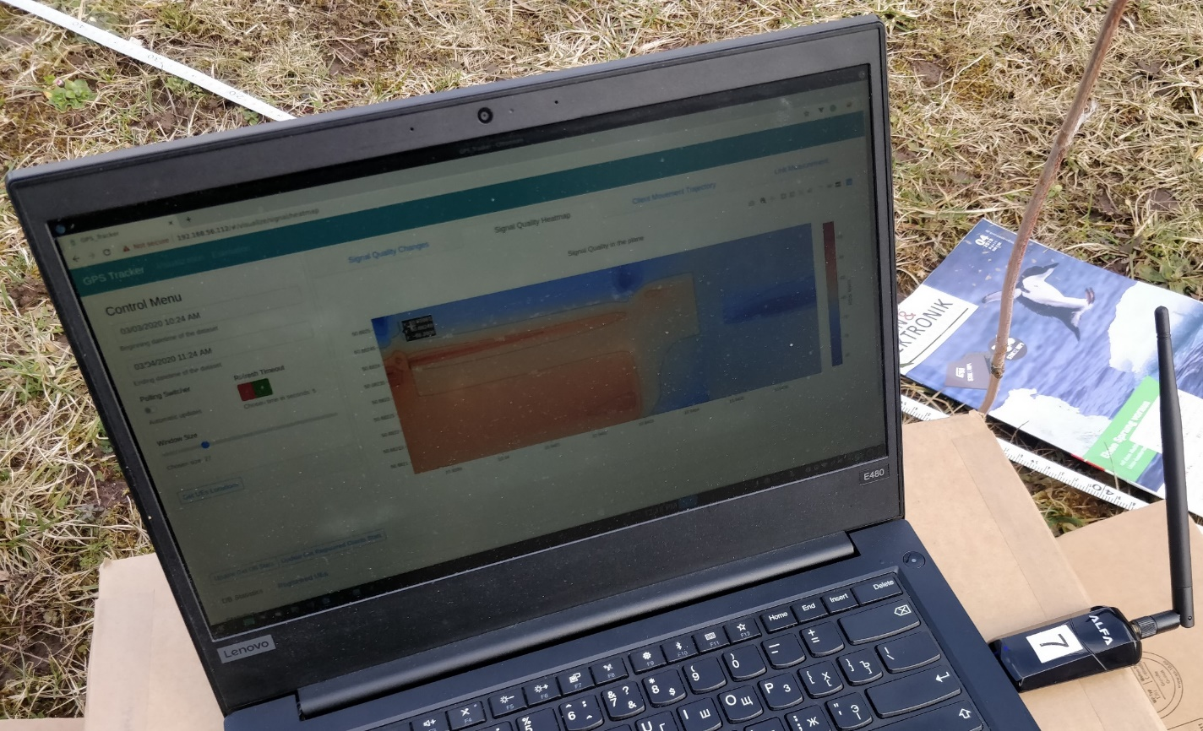
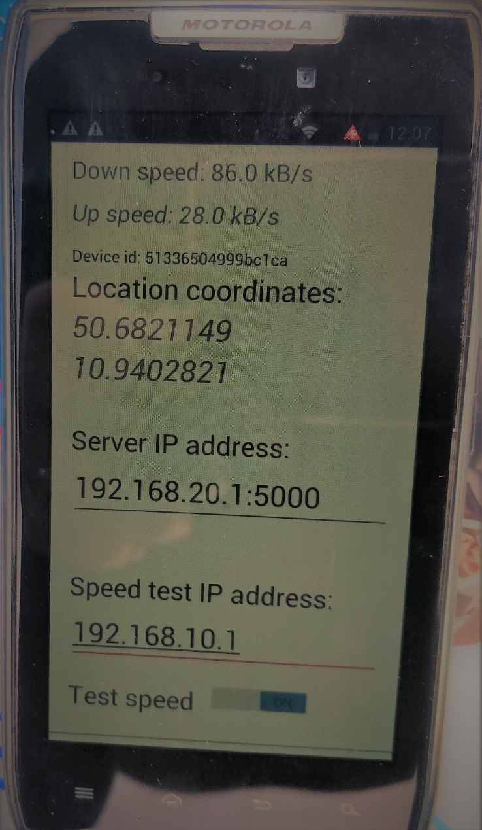
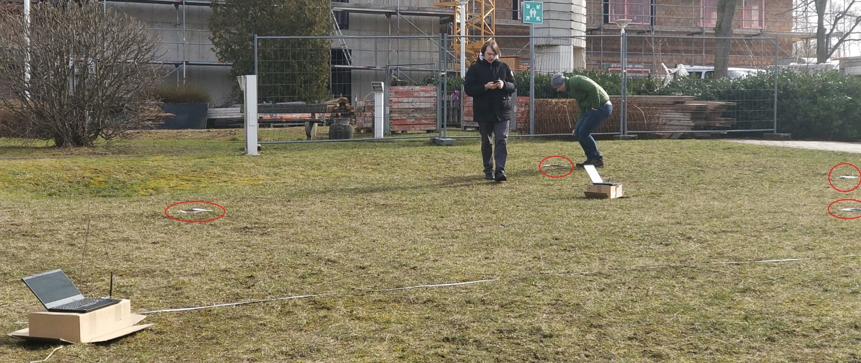
Appendix. Experiment 4/4
Notes:
Zufar
<номер>

